Slide 1
Databases– Part 2
Lesson 3 & 4
http://www.yahmad.co.uk/

Slide 2
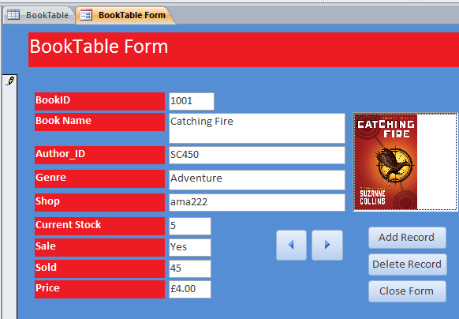
Starter 1 –
Features of a well designed input form
List 5 Features
1)
2)
3)
4)
5)
http://www.yahmad.co.uk/

Slide 3
Lesson Overview
Objectives
To understand the purpose of a user input form.
To understand positive design features of a user input form.
To understand the advantage of using a user input form
Outcomes |  | Time
Task 1 | Paper based designs for input forms.
Task 2 | Input forms for each table
Task 3 | Enter New Records using the data Entry Form
http://www.yahmad.co.uk/

Slide 4
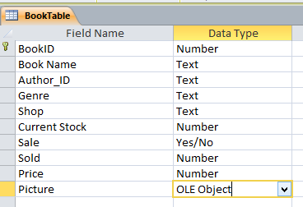
Task 1 & (Designing and Creating Form)
Design Form
Your task is to create a data entry form for each table in your database. Refer to the example and apply positive design features to your form. Add appropriate images for each record.
Add a new picture field in design view. Set the data type to OLE Object.
http://www.yahmad.co.uk/

Slide 5
Plenary – Refer to the Lesson Objectives
Objectives
To understand the purpose of a user input form.
To understand positive design features of a user input form.
To understand the advantage of using a user input form
Plenary Task (Q&A)
Peer Assess each others work and suggest possible improvements. Discuss the levels pupils have achieved for this task.
http://www.yahmad.co.uk/

